Slide 1
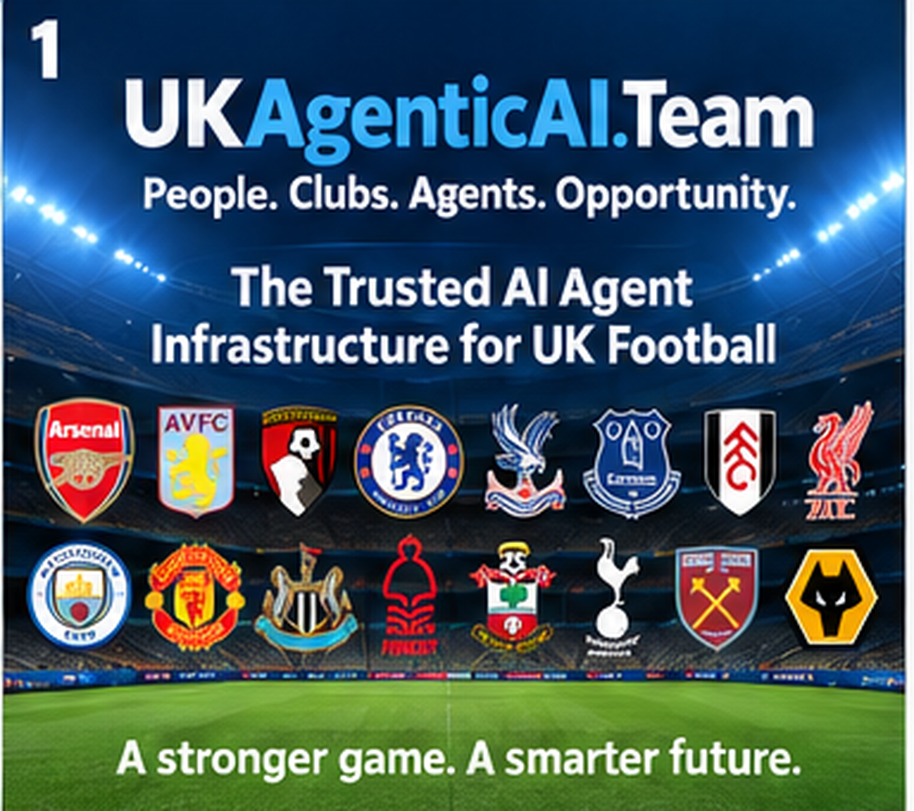

Slide 2
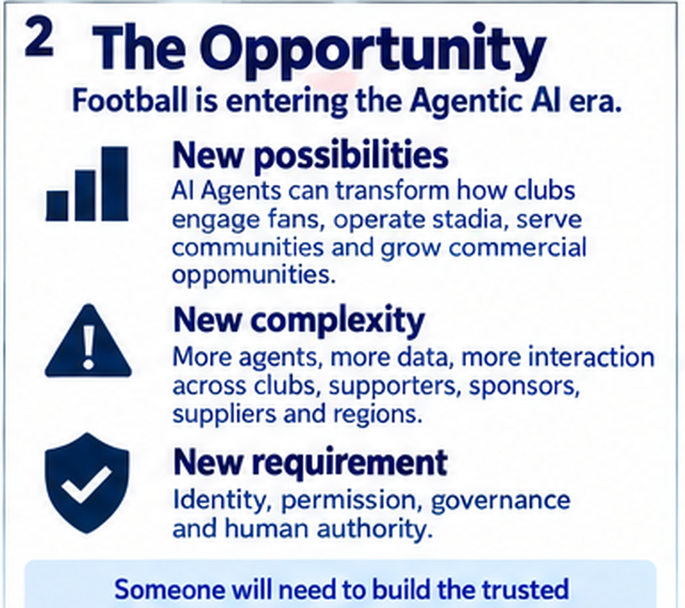
2
The Opportunity
Football is entering the Agentic AI era.
3 shifts
change the game
01
02
03
NEW
POSSIBILITIES
NEW
COMPLEXITY
NEW
REQUIREMENT
Fan engagement
Stadium operations
Communities
Commercial growth
More agents
More data
More interactions
More counterparties
Identity
Permission
Governance
Human authority
The opportunity is not simply more AI.
It is trusted AI infrastructure for football.
Someone will need to build the trusted infrastructure. That is the opportunity.
UKAgenticAI.Team
A stronger game. A smarter future.

Slide 3
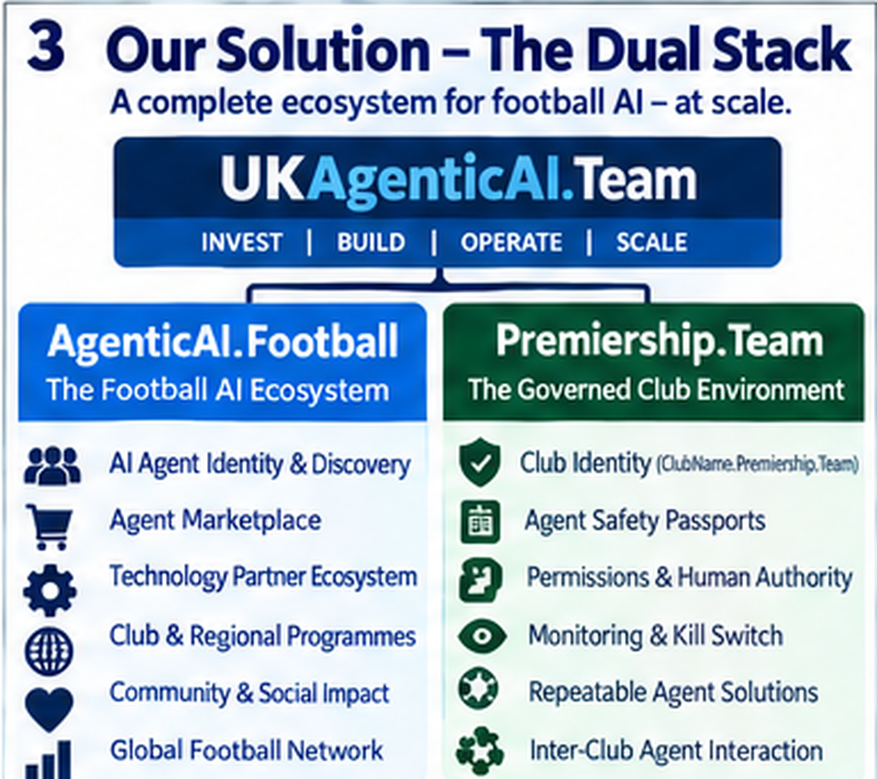

Slide 4
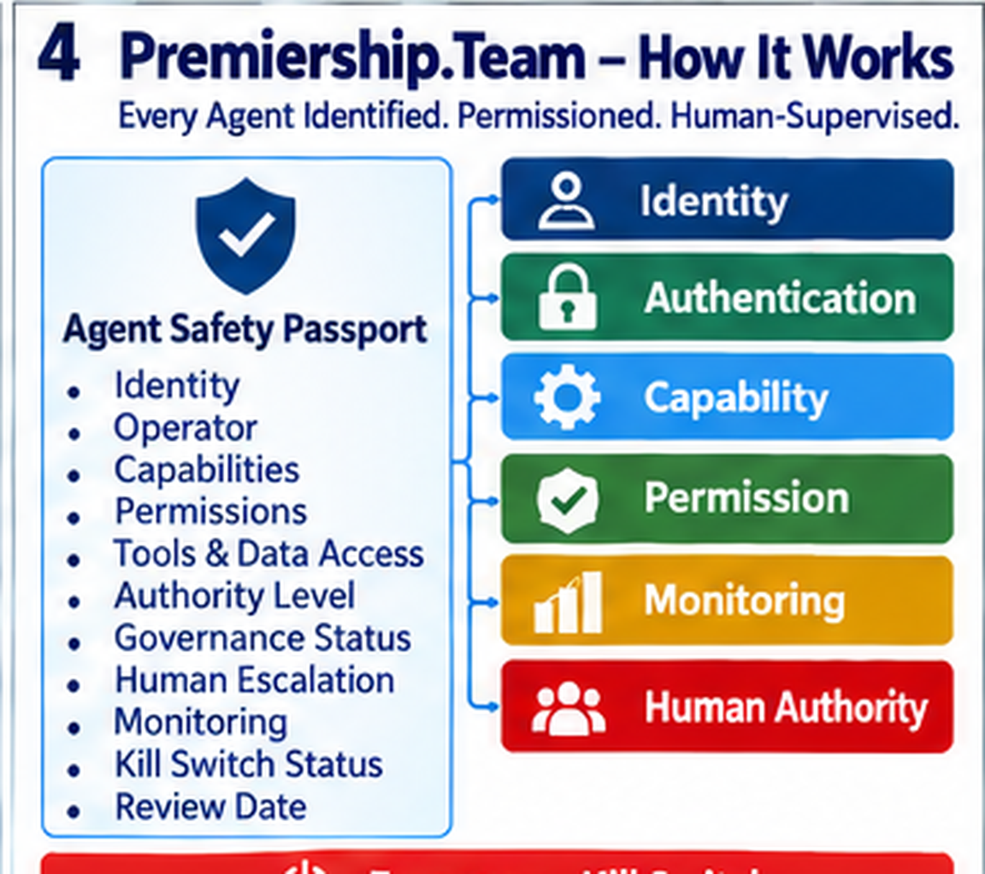
4
Premiership.Team — How It Works
Every Agent identified. Permissioned. Human-supervised.
01
IDENTITY
AGENT
SAFETY
PASSPORT
02
AUTHENTICATION
Identity
Operator
Capabilities
Permissions
Tools + data
Authority level
Governance status
Human escalation
03
CAPABILITY
04
PERMISSION
05
MONITORING
06
HUMAN AUTHORITY
EMERGENCY KILL SWITCH → Suspend • Revoke • Disable Access • Alert • Audit
UKAgenticAI.Team
A stronger game. A smarter future.

Slide 5
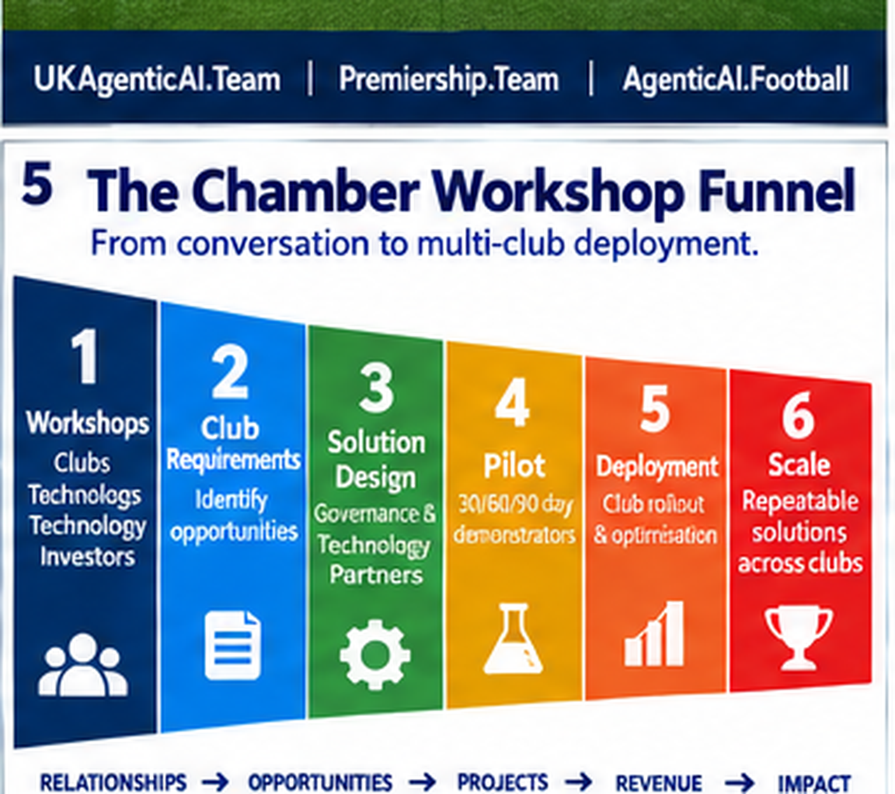
5
The Chamber Workshop Funnel
From conversation to multi-club deployment.
1
2
3
4
5
6
WORKSHOP
REQUIREMENTS
DESIGN
PILOT
DEPLOY
SCALE
Convene clubs,
technology,
investors
Identify club
opportunities
Governance +
technology
30 / 60 / 90-day
demonstrators
Club rollout +
optimisation
Repeat across
clubs
RELATIONSHIPS → OPPORTUNITIES → PROJECTS → REVENUE → IMPACT
One workshop can become a repeatable multi-club pipeline.
UKAgenticAI.Team
A stronger game. A smarter future.

Slide 6
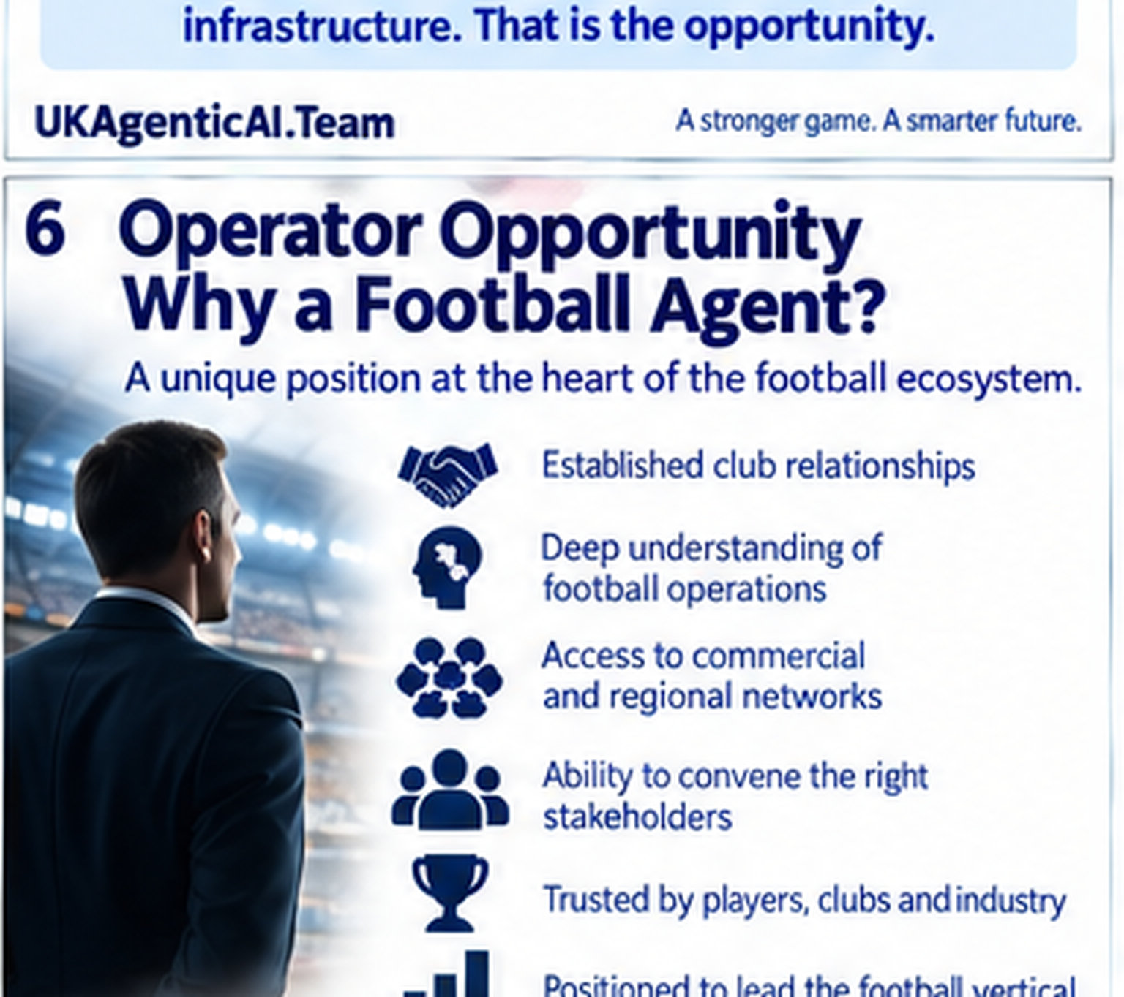
6
Operator Opportunity
Why a football agent?
RELATIONSHIPS
BECOME
INFRASTRUCTURE
CLUB ACCESS
Established club relationships
FOOTBALL KNOWLEDGE
Deep operational understanding
COMMERCIAL REACH
Regional + commercial networks
From representing people
to enabling trusted AI Agents
across the football ecosystem.
CONVENING POWER
Bring the right stakeholders together
TRUST
Credibility with players, clubs + industry
LEADERSHIP
Operate the football vertical
UKAgenticAI.Team
A stronger game. A smarter future.

Slide 7
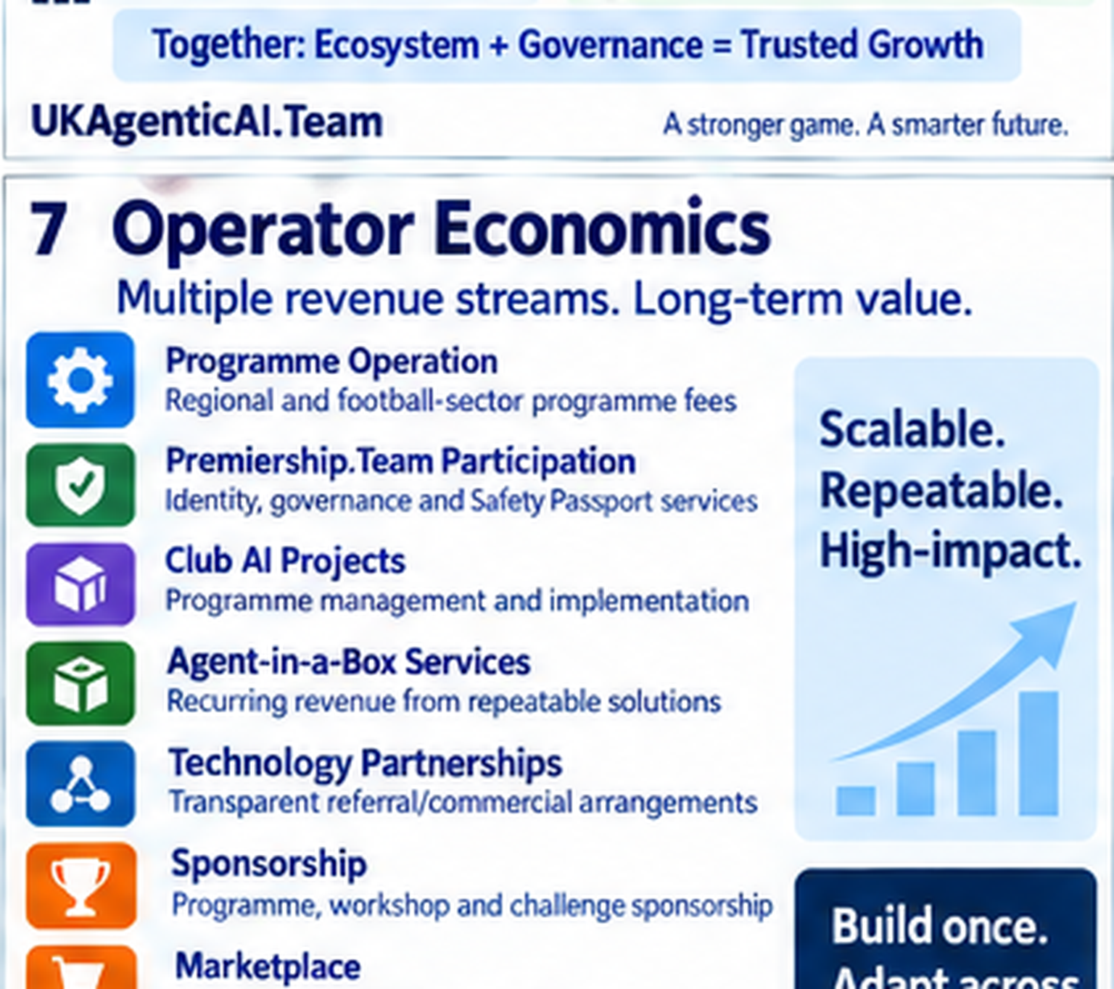
7
Operator Economics
Multiple revenue streams. One scalable platform.
BUILD ONCE.
PROGRAMME
OPERATION
PREMIERSHIP.TEAM
ADAPT ACROSS
FOOTBALL.
Regional + sector fees
Identity + governance
The operator participates across the value chain — from programme creation to recurring services.
CLUB AI
PROJECTS
AGENT-IN-A-BOX
Programme + implementation
Recurring services
PARTNERSHIPS
SPONSORSHIP +
MARKETPLACE
Transparent commercial arrangements
Ecosystem revenue
UKAgenticAI.Team
A stronger game. A smarter future.

Slide 8
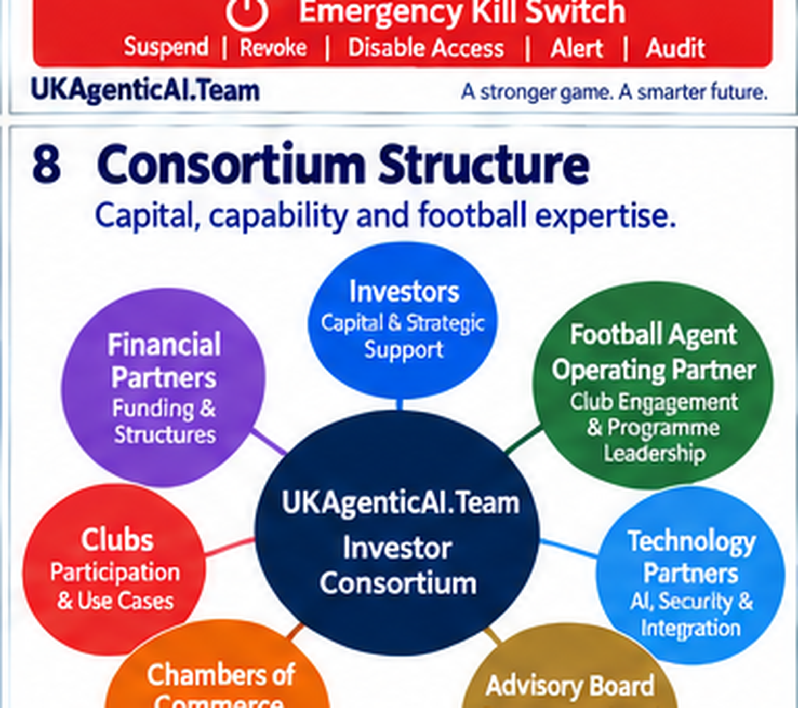
8
Consortium Structure
Capital + capability + football expertise.
INVESTORS
Capital + strategic support
CLUBS
FOOTBALL AGENT
Participation + use cases
Operating partner
UKAgenticAI.Team
INVESTOR CONSORTIUM
CHAMBERS
TECH PARTNERS
Regional programmes
AI + security + integration
ADVISORY BOARD
Governance + legal + ethics
UKAgenticAI.Team
A stronger game. A smarter future.

Slide 9
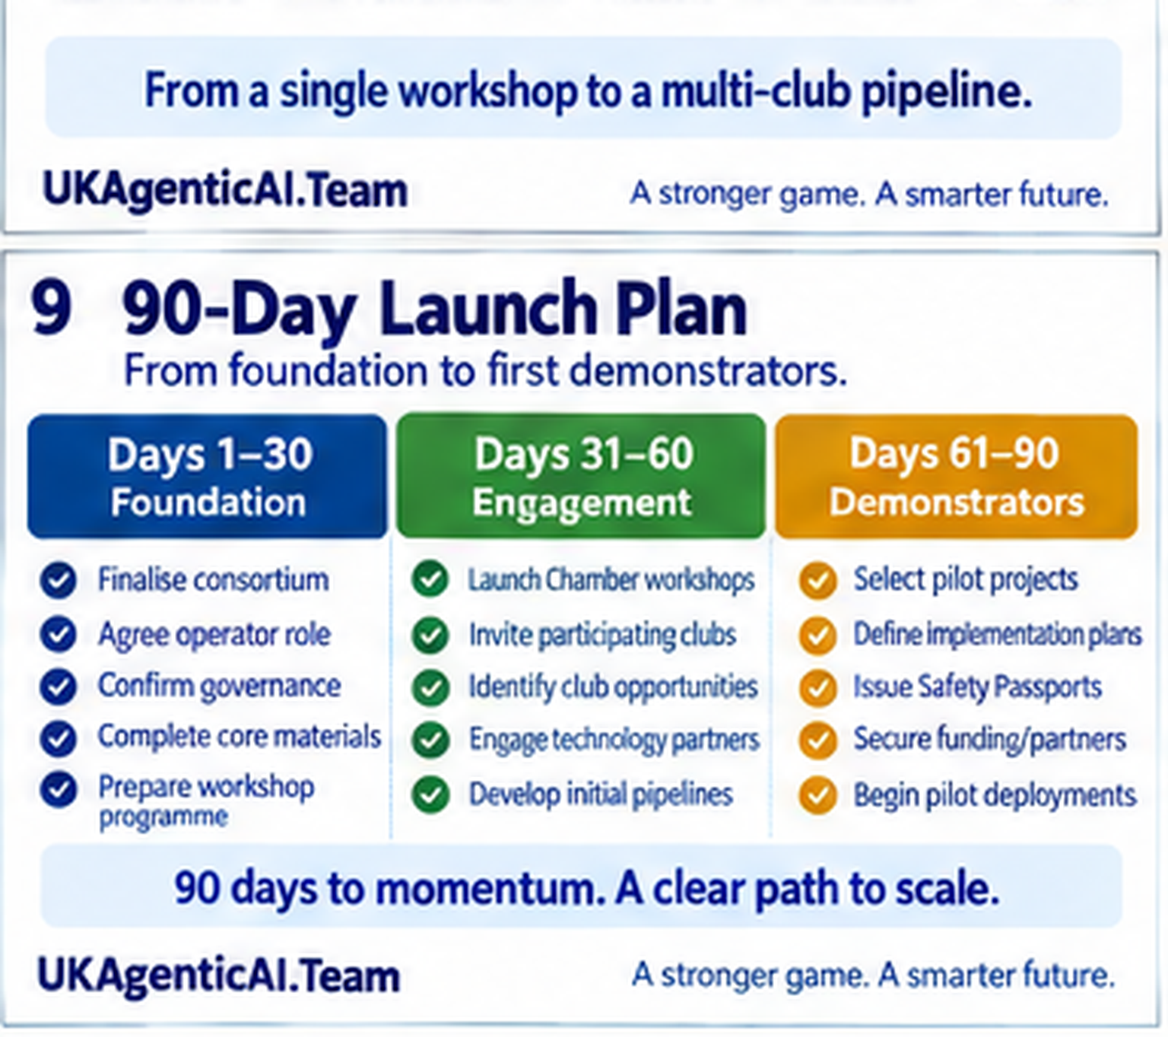
9
90-Day Launch Plan
From foundation to first demonstrators.
DAYS 1–30
DAYS 31–60
DAYS 61–90
FOUNDATION
ENGAGEMENT
DEMONSTRATORS
1
Finalise consortium
1
Launch Chamber workshops
1
Select pilot projects
2
Agree operator role
2
Invite participating clubs
2
Define implementation
3
Confirm governance
3
Identify club opportunities
3
Issue Safety Passports
4
Complete core materials
4
Engage technology partners
4
Begin pilot deployments
90 DAYS TO MOMENTUM → GOVERN • ENGAGE • DEMONSTRATE
UKAgenticAI.Team
A stronger game. A smarter future.

Slide 10
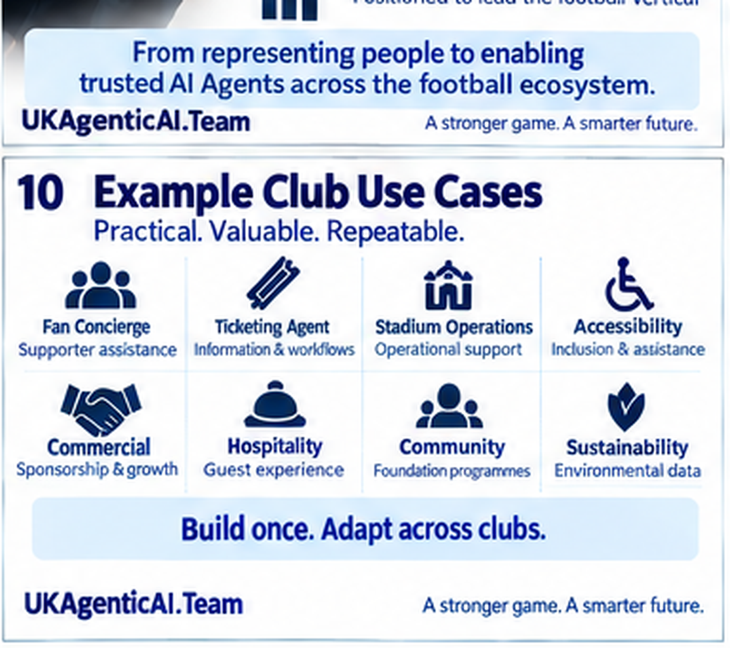
10
Example Club Use Cases
Practical. Valuable. Repeatable.
FAN
TICKETING
STADIUM
ACCESSIBILITY
CONCIERGE
AGENT
OPERATIONS
AGENT
Supporter assistance
Information + workflows
Operational support
Inclusion + assistance
COMMERCIAL
HOSPITALITY
COMMUNITY
SUSTAINABILITY
AGENT
AGENT
AGENT
AGENT
Sponsorship + growth
Guest experience
Foundation programmes
Environmental data
BUILD ONCE. ADAPT ACROSS CLUBS.
UKAgenticAI.Team
A stronger game. A smarter future.

Slide 11
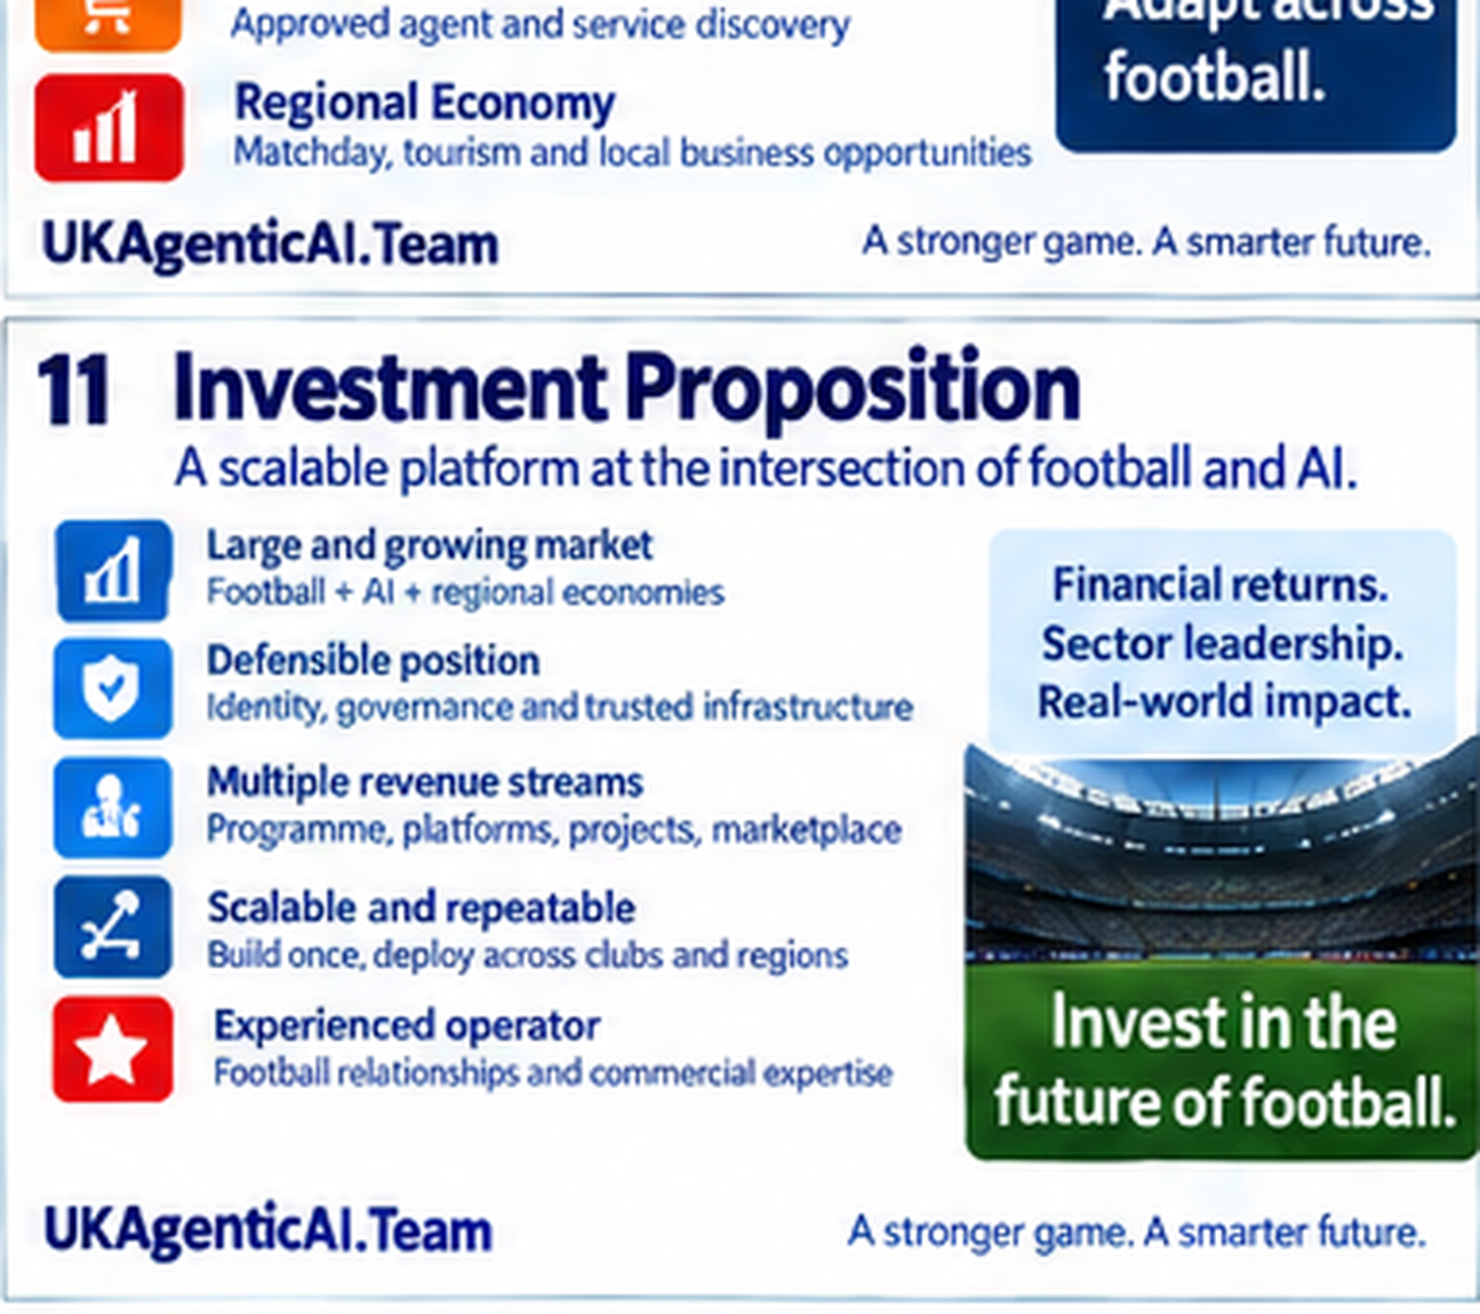
11
Investment Proposition
A scalable platform at the intersection of football and AI.
INVEST IN
THE TRUST
LAYER.
Football + AI + regional economies
MARKET
POSITION
Identity, governance + trusted infrastructure
The value sits between AI capability and football adoption:
REVENUE
Programme + platforms + projects + marketplace
IDENTITY
GOVERNANCE
DEPLOYMENT
REPEATABILITY
SCALE
Build once; deploy across clubs + regions
OPERATOR
Football relationships + commercial expertise
FINANCIAL RETURNS • SECTOR LEADERSHIP • REAL-WORLD IMPACT
UKAgenticAI.Team
A stronger game. A smarter future.

Slide 12
